Slide 1
The DynamoDB Data Model
Section 1

Slide 2
Relational Databases versus NoSQL

Slide 3
There Will Be a Lot of Data Buzzwords in This Course
Relational Database – a relational application database, where data is organized into tables, against which queries are run

Slide 4
There Will Be a Lot of Data Buzzwords in This Course
Relational Database – a relational application database, where data is organized into tables, against which queries are run
Data Warehouse – a centralized relational data store for business intelligence

Slide 5
There Will Be a Lot of Data Buzzwords in This Course
Relational Database – a relational application database, where data is organized into tables, against which queries are run
Data Warehouse – a centralized relational data store for business intelligence
NoSQL – a broad term, categorizing databases, that store data, but cannot be queried with SQL

Slide 6
There Will Be a Lot of Data Buzzwords in This Course
Relational Database – a relational application database, where data is organized into tables, against which queries are run
Data Warehouse – a centralized relational data store for business intelligence
NoSQL – a broad term, categorizing databases, that store data, but cannot be queried with SQL
Big Data – officially meaningless, but usually refers to the tools you use to process data, in a way that can be scaled out horizontally

Slide 7
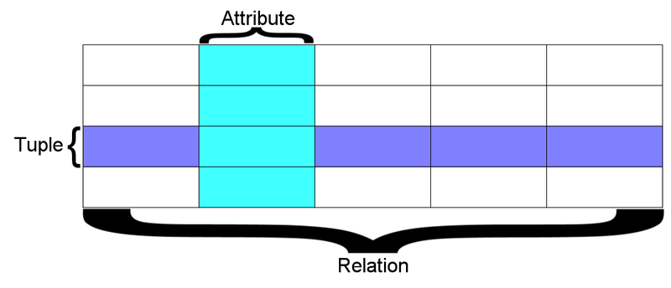
Relational Database

Slide 8
Relational Database (Continued)

Slide 9
Databases – Relational Database Fundamentals
Data is organized in one or more tables

Slide 10
Databases – Relational Database Fundamentals
Data is organized in one or more tables
Each table is made up of rows

Slide 11
Databases – Relational Database Fundamentals
Data is organized in one or more tables
Each table is made up of rows
A row represents a single item, and it must be unique within the table

Slide 12
Databases – Relational Database Fundamentals
Data is organized in one or more tables
Each table is made up of rows
A row represents a single item, and it must be unique within the table
A column represents a named attribute of the row

Slide 13
Databases – Relational Database Fundamentals
Data is organized in one or more tables
Each table is made up of rows
A row represents a single item, and it must be unique within the table
A column represents a named attribute of the row
All the rows within a table must adhere to the table’s defined schema

Slide 14
Databases – Relational Databases Fundamentals (Continued)
CourseID | CourseName | Location | Cost
1 | Drawing | Madrid | 70
2 | Public speaking | London | 180
3 | Photography | New York | 150
4 | Painting | Paris | 200

Slide 15
Popular Relational Database Engines
Oracle

Slide 16
Popular Relational Database Engines
Oracle
SQL Server

Slide 17
Popular Relational Database Engines
Oracle
SQL Server
MySQL

Slide 18
Popular Relational Database Engines
Oracle
SQL Server
MySQL
PostgreSQL

Slide 19
Popular Relational Database Engines
Oracle
SQL Server
MySQL
PostgreSQL
Amazon Aurora

Slide 20
Popular Relational Database Engines
Oracle
SQL Server
MySQL
PostgreSQL
Amazon Aurora
MariaDB

Slide 21
What Is DynamoDB?
Fast, scalable, and fully managed NoSQL database service

Slide 22
What Is DynamoDB?
Fast, scalable, and fully managed NoSQL database service
Supports both key-value and document store models

Slide 23
What Is DynamoDB?
Fast, scalable, and fully managed NoSQL database service
Supports both key-value and document store models
Use cases: Web, mobile, gaming, IoT, and other apps, that need consistent latency

Slide 24
Attempting To Make Sense of All of This
Big Data
No SQL
Scalability
DW
RDBMS
Query response time

Slide 25
So NoSQL Is the Winner

Slide 26
Slow Down a Second
NoSQL databases can loosely be classified by the data structure they support

Slide 27
Slow Down a Second
NoSQL databases can loosely be classified by the data structure they support
Key value: Like a persistent map, only the key is indexed, so fetching by value is very expensive
Example – Redis

Slide 28
Slow Down a Second
NoSQL databases can loosely be classified by the data structure they support
Key value: Like a persistent map, only the key is indexed, so fetching by value is very expensive
Example – Redis
Document: Like a key value store, but with the ability to index elements of the value as well
Example – MongoDB

Slide 29
Slow Down a Second (Continued)
Columnar: Data is stored by column instead of by row, making it better for scanning subsets of the table
Example: Cassandra

Slide 30
Slow Down a Second (Continued)
Columnar: Data is stored by column instead of by row, making it better for scanning subsets of the table
Example: Cassandra
Graph: Data is stored as a collection of nodes and edges, making it possible to query the relationships between them
Example: Neo4J

Slide 31
Data Structures Limit Query Flexibility
NoSQL databases scale well and respond quickly, because their data structures are optimized, so that they can be easily partitioned

Slide 32
Data Structures Limit Query Flexibility
NoSQL databases scale well and respond quickly, because their data structures are optimized, so that they can be easily partitioned
The downside is that the query DSL is significantly limited, compared to a relational database

Slide 33
Data Structures Limit Query Flexibility
NoSQL databases scale well and respond quickly, because their data structures are optimized, so that they can be easily partitioned
The downside is that the query DSL is significantly limited, compared to a relational database
You need to model your data with your applications access pattern in mind, from the start

Slide 34
Data Structures Limit Query Flexibility
NoSQL databases scale well and respond quickly, because their data structures are optimized, so that they can be easily partitioned
The downside is that the query DSL is significantly limited, compared to a relational database
You need to model your data with your applications access pattern in mind, from the start
Getting this wrong can be extremely messy

Slide 35
Comparing the Tools Again
RDBMS
Query flexibility
DW
Big Data
No SQL
Query response time

Slide 36
The DynamoDB Data Model
Next Video

Slide 37
Slow Down a Second
Columnar: Data is stored by column instead of by row, making it better for scanning subsets of the table
Example: Cassandra
Graph: Data is stored as a collection of nodes and edges, making it possible to query the relationships between them
Example: Neo4J

